Slide 2
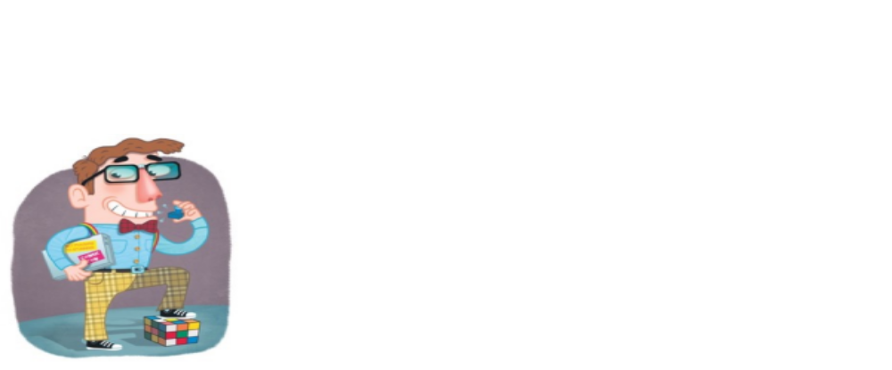
“When I grow up, I want to be the meekest man on earth!”
What would you think?
Galatians 5:22,23

Slide 3
Meekness Defined:
“Humble in spirit or manner; cowed submissiveness”
“Compliant: overly submissive or compliant”

Slide 4
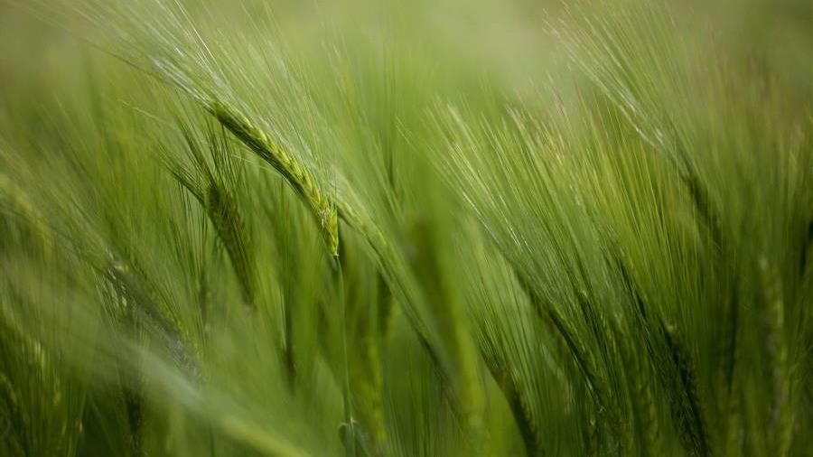
Bible definition of Meek:
Greek word - prautes πραΰς
W.E. Vine “πραΰς describes a condition of mind and heart, and as gentleness is appropriate rather to actions, this word is no better that that used in both English Versions… Described negatively, meekness is the opposite to self-assertiveness and self-interest; it is composure of spirit that is neither elated nor cast down, simply because it is not occupied with self at all.”

Slide 5
“A Total lack of self-pride, to the point of a lack of self-concern”
Related to HUMILITY but NOT the same
Isaiah 11:4 – “poor” – “meek”
All Christians to have – Titus 3:1,2 “showing all humility [meekness] to all men.”
In Old Testament Hebrew for “meek” is anaw עָנָיו
Defined: “humble, afflicted, poor, oppressed” “describes the intended outcome of affliction from God, namely “humility.” In its first appearance the word depicts the objective condition as well as the subjective stance of Moses. He was entirely dependent on God and saw that he was.”

Slide 6
Example of moses
Numbers 12:3 “Moses was very humble [meek (ASV)], more than all men who were on the face of the earth.”
How can this be?
In a fit of anger, he broke the tables of stone! Exodus 32:19
Wasn’t it Moses who burnt the golden idol, ground it up, poured the powder into water and made the people drink of it? Exodus 32:20
Does this sound like a mild-mannered, unassuming guy?

Slide 7
Example of moses
Numbers 12:1-3 Aaron & Miriam were giving him grief because he married a woman from Ethiopia
They openly insinuated that since God has spoken through them in the past, there was no need to follow Moses if they didn’t want to do so!
Moses never complained to God about this. He chose to bear the burden
V.2 God stepped in and did something about the matter
Moses was not a person to bring personal problems to God

Slide 8
Example of moses
Exodus 18:13-23
Moses wearing himself out trying to help everyone solve their problems
Never complained – willingly bore problems
Father-in-law saw the problem and said it was not good
Moses needed to take this matter before God V.19
Needed to train men to assume some of the burden
Meekness wasn’t a character of timidity
He carried burdens most would crumble under and never complained- not even to God!

Slide 9
Example of jesus
Matthew 11:29 “I am gentle [meek (ASV)] and lowly in heart…”
Twice Jesus threw merchants/moneychangers out of the Temple – John 2:14-17; Matthew 21:12,13
He is telling us that He is willing to take up our heavy loads and bear them – Gives us light loads
Isaiah 53:4-7 “borne our griefs”
A willingness to bear the burdens of others with no thought of self, without a complaint
Jesus bore much on our behalf – that is meekness!

Slide 10
Example of jesus
1 Peter 2:21-25 “who Himself bore our sins in His own body on the tree”
Jesus wasn’t weak or cowardly
Matthew 26:50-54 “Or do you think that I cannot now pray to My Father, and He will provide Me with more than twelve legions of angels?”
Jesus not concerned about Himself – Philippians 2:4-8 “coming in the likeness of men. 8 And being found in appearance as a man, He humbled Himself and became obedient to the point of death, even the death of the cross.”

Slide 11
Meekness of a Christian
1 Peter 2:19-21 “Christ also suffered for us, leaving us an example, that you should follow His steps:”
Colossians 3:12,13 “put on tender mercies, kindness, humility, meekness, longsuffering..”
Meekness, longsuffering, bearing with one another
Forgiving if anyone has a complaint
Do the best you can and carry the load
Galatians 6:1,2 - Restore with the attitude of meekness.
Bear one another’s burdens, that is the law of Christ.
1 Peter 3:3,4 “hidden person of the heart…”
1 Timothy 6:11,12 “fight the good fight of faith…”

Slide 12
Have you given thought
TO HOW ODD IT IS TO MENTION MEEKNESS AND THEN IN THE VERY NEXT PHRASE SAY, “FIGHT THE GOOD FIGHT?”
We are going to be opposed!
Shoulder the burden!
Give no thought for yourself, but battle for the Lord!

